Slide 1
Getting Started With AngularJS
View AngularJS course details at www.edureka.co/angular-js

Slide 2





What will you learn today?
Why should we use AngularJS?
What is AngularJS?
Big Brands Using AngularJS
AngularJS Features
AngularJS MVC & MVW Architecture
Basic AngularJS Program
Directives and Filters
What is Single Page Application
How to Build a Responsive Single Page Application

Slide 3
Why AngularJS ?

Slide 4
Why AngularJS?
Has a Declarative User Interface as it uses HTML for UI
Enables Parallel Development
Supports Single Page Applications
Write less code
Unit testing ready
You can create custom HTML elements and attributes

Slide 5

Why AngularJS?
Supports Single Page Applications
Enables Massively Parallel Development
Have a Declarative User Interface as it used HTML for UI
You can create custom HTML elements and attributes
Write less code
Unit testing ready

Slide 6
What is AngularJS ?

Slide 7


What is AngularJS?
<html> enhanced for web applications
OpenSource client side JavaScript framework created by Google
A framework for creating dynamic web applications
Best suited for Single Page Application
AngularJS was originally developed in 2009 by Misko Hevery and Adam Abrons at Brat Tech LLC, firstly named as GetAngular

Slide 8







Big Brands Using AngularJS
YouTube application for Sony's PlayStation 3
Go To : www.madewithangular.com

Slide 9
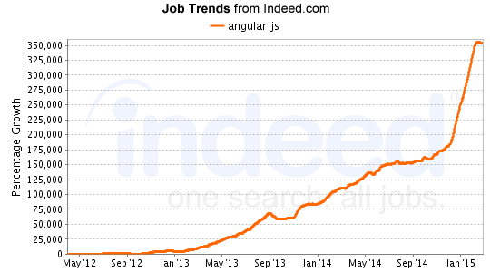
AngularJS Job Trends

Slide 10
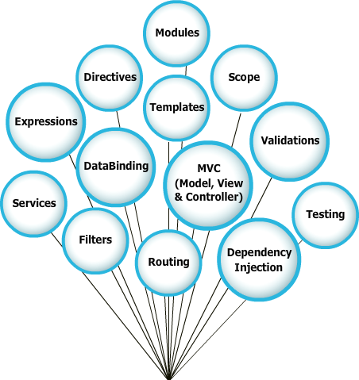
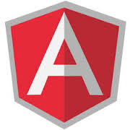
Features of AngularJS

Slide 11

MVC & MVW Way of AngularJS
MVC
MVW
Model
View
Model
View
HTML
HTML
CSS
CSS
2 way data binding
2 way data binding
Whatever
Controller
JavaScript
Controller
Directive
Unit Test
Services

Slide 12
AngularJS: Key Terms
Directives: A directive is a function that executes
Expressions: Expressions are javascript code snippets
Forms: Forms and inputs provide validation services
Modules: provide a means to specify how an application is started
Routing: Routing provides a mechanism for linking URL’s to controllers and views
Scope: Scope refers to the application model. It establishes a connection between application controller and view
Filters: Filters provide a means to format data before displaying them

Slide 13
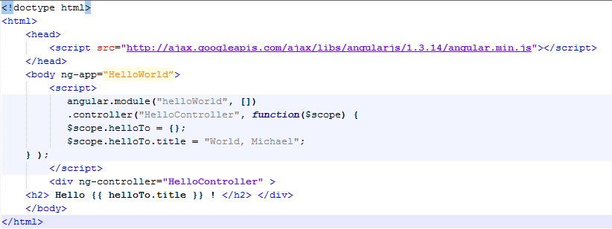
AngularJS: Your First Program
Steps to create an AngularJS Application
Include AngularJS

Slide 14
AngularJS: Your First Program
Steps to create an AngularJS Application
2. Bootstrap the App

Slide 15
AngularJS: Your First Program
Steps to create an AngularJS Application
3. Create the Controller

Slide 16
AngularJS: Your First Program
Steps to create an AngularJS Application
4. Create the View

Slide 17
AngularJS Directives
The process of rendering of HTML inside the AngularJS application are controlled by Directives
Directives guide the HTML compiler to control the DOM elements by attaching specific behavior to the elements
Directive
Directive

Slide 18
Built in Directives
Name | Description
ngJq | Use this directive to force the angular.element library. This should be used to force either Jqlite by leaving ng-jq blank or setting the name of the jQuery variable under window (eg. jQuery)
ngApp | Use this directive to auto-bootstrap an AngularJS application. The ngApp directive designates the root elementof the application and is typically placed near the root element of the page - e.g. on the <body> or <html> tags
a | Modifies the default behavior of the html A tag so that the default action is prevented when the href attribute is empty
ngDisabled | This directive sets the disabled attribute on the element if the expression inside ngDisabled evaluates to truthy
form | Directive that instantiates FormController
ngClass | The ngClass directive allows you to dynamically set CSS classes on an HTML element by databinding an expression that represents all classes to be added
ngController | The ngController directive attaches a controller class to the view. This is a key aspect of how angular supports the principles behind the Model-View-Controller design pattern
For rest of the directives refer https://docs.angularjs.org/api/ng/directive

Slide 19
AngularJS Filters
It formats the value of an expression for display to the user
Filters in view templates can be used with the following syntax
{{ expression | filter }}
Filters are generally injected when used with controllers, services and directives
With filters data can be organized to meet certain criteria
UpperCase
LowerCase
Currency
{{entity.name() | uppercase}}
{{entity.name() | lowercase}}
{{entity.amount() | currency}}

Slide 20
Filter Types
Generally used filter types
Name | Usage
uppercase | Change case of string to uppercase
lowercase | Change case of string to lowercase
currency | Formats string to currency format
number | Formats numerical value
json | Json representation
date | Formats date
filter | Filters array based on criteria
orderBy | Orders array based in criteria
limitTo | Limits number of objects

Slide 21
Single Page Application
Single-Page Applications (SPAs) are Web apps that load a single HTML page and dynamically update that page as the user interacts with the app
In a Single Page Application or SPA the page never reloads, though parts of the page may refresh. This reduces the round trips to the server to a minimum
Client Side Routing
Client Side Rendering

Slide 22
How To Build Responsive SPA Using AngularJS ?

Slide 23
Building Highly Responsive Single Page Application
Usecase : Build a User Management Application
Prerequisite :
Text Editor (sublime or notepadd ++)
Latest browser (Firefox or Chrome)
Installed NodeJS (server)
Mongo (To store userinfo)
Project Specifications :
Login to the Application
Create a new user
View Users List
Update a existing user
Delete user
Signout

Slide 24

Certifications
Get certified in AngularJS by Edureka
Go to www.edureka.co/angular-js
Batch starts from 24th October (Weekend)
Edureka's AngularJS course:
It covers the fundamental concepts like directives, routes, filters, services and factors which helps to build rich user interface web applications in AngularJS.
It helps you boost your web development skills and become a sought after SPA (single page application) developer. You will learn the highly efficient Angular features like data binding, scope management, form validation, routing, i18n & lot more.
Get to work on a To-Do List App Project towards the end of the course, which gives you complete insights on the Node.js framework.
Online Live Courses: 21 hours
Assignments: 20 hours
Project: 20 hours
Lifetime Access + 24 X 7 Support

Slide 25
Thank You
Questions/Queries/Feedback
Recording and presentation will be made available to you within 24 hours

